Slide 1
Domain Models
Lecturer: Ngo Huy Bien
Software Engineering Department
Faculty of Information Technology
VNUHCM - University of Science
Ho Chi Minh City, Vietnam
nhbien@fit.hcmus.edu.vn

Slide 2

Objectives
To create a domain model for a software system.

Slide 3

Contents
Domain Models.

Slide 4

References
Craig Larman (2004). Applying UML And Patterns. 3rd Edition. Prentice Hall.
Colin Atkinson and Thomas Kuhne (2008). Reducing Accidental Complexity in Domain Models.
Suzanne Robertson and James Robertson (2012). Mastering the Requirements Process. Addison Wesley Professional.

Slide 5
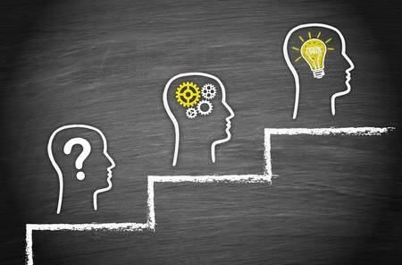
Problem Analysis and Specification
The purpose of software is to solve problems.
How do we analyze and document a problem?
Solution
Analysis
Problem

Slide 6
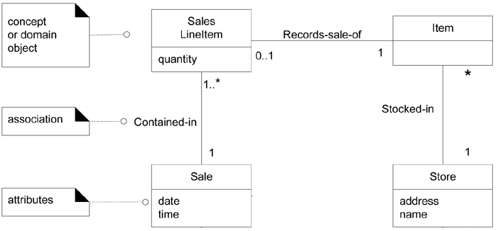
What is Domain Model? [1]
Informally, a conceptual class is an idea, thing, or object that has symbol, intention and examples.
A domain model is a visual representation of conceptual classes or real-situation objects in a domain.
Elements of a domain model are domain object classes, and the relationships between them.

Slide 7
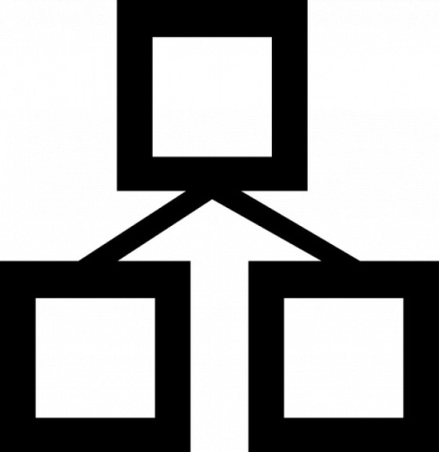
Input for Domain Model Creation
Input for domain model creation
Executive Summary
Project Vision and Scope
Domain Knowledge, Existing Domain Models

Slide 8
How to Create a Domain Model?
Find the conceptual classes
Draw them as classes in a UML class diagram
Add associations and attributes.
Listen to the core vocabulary and concepts that domain experts use.
Use noun phrase identification: Identify the nouns and noun phrases in textual descriptions of a domain
Reuse or modify existing models.

Slide 9

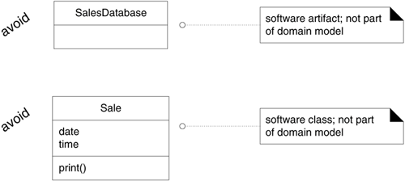
Domain Model vs. Software Business Objects
A DOMAIN MODEL SHOWS REAL-SITUATION CONCEPTUAL CLASSES, NOT SOFTWARE CLASSES.
A DOMAIN MODEL DOES NOT SHOW SOFTWARE ARTIFACTS OR CLASSES.

Slide 10

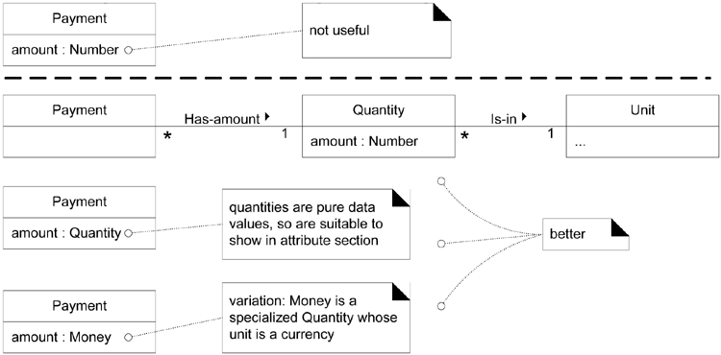
Attributes vs. Classes
If we do not think of some conceptual class X as a number or text or date/time in the real world, X is probably a conceptual class, not an attribute.

Slide 11
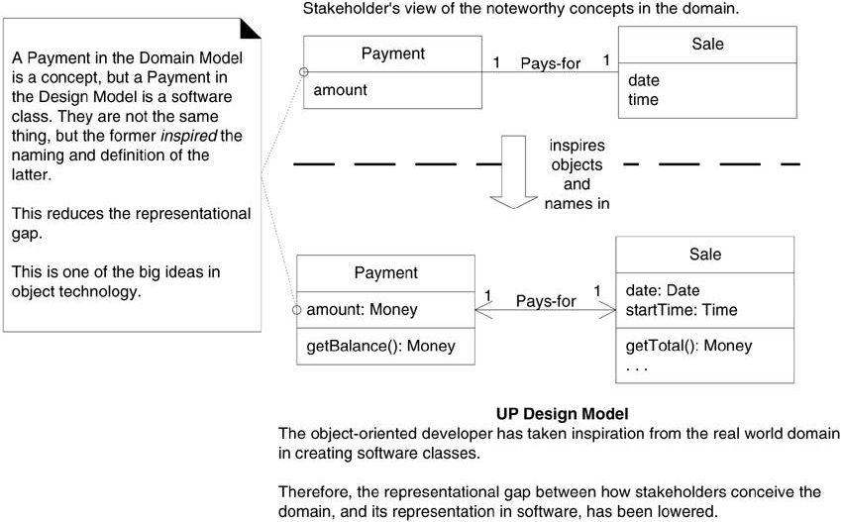
Why Domain Models?
This supports a low representational gap between our mental and software models.

Slide 12


Slide 13

Domain Model? [2]
"Domain model" or "analysis model": a solution-independent description of the problem to be solved.
A domain model is assumed to represent a conceptualization of the entities of some problem domain.
The most common choice for creating such domain models is the modeling language standard, the UML.
Creating a domain model with the UML usually includes the creation of one or more class diagrams that capture the important domain concepts and their relationships.
Often one also adds one or more object diagrams showing instances of the domain concepts to illustrate various configurations.

Slide 14

Why Domain Models?
To serve as a description of the problem that is understandable to the widest possible range of stakeholders.

Slide 16
Business Model [1]
A domain model is defined as an abstract model that captures the most important types of objects in the context of the system.
The domain objects represent the "things" that exist or events that transpire in the environment in which the system works.
A business model comprises two models:
a business use-case model to describe
the business actors and the business processes,
and a business object model to describe
business entities used by the business use cases.

Slide 17
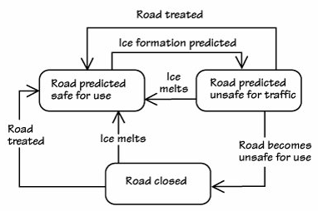
State Model [3]
The object life history is a state model (also known as a state transition diagram) that shows which states the objects for a class (sometimes called entities) may take, and illustrates the transitions between those states.
A state is a steady condition for the object, and each rectangle in the model identifies a different state that this object will be in at one time or another.
The story is told not so much by the states, as by the transitions between states.

Slide 18

Thank You & See You Again

